Slide 1
22AIE450 - SPEECH PROCESSING
Multi – Speaker Speech Separation Using
Spatial and Acoustic Audio Features

Slide 2
Introdution
In real-world environments, multiple people often speak at the same time, making it difficult to separate individual voices.
Our project, "Multi-Speaker Speech Separation Using Spatial and Acoustic Audio Features," focuses on isolating each speaker.
Applications in teleconferencing, hearing aids.

Slide 3
Objective
The objective of this project is to create a system that can separate voices from multiple speakers in audio recordings.
This will be done using spatial & acoustic audio features, like the direction and level differences of sounds, to identify and isolate each speaker.
The goal is to improve speech clarity in situations where multiple people are speaking at once.

Slide 4
Literature Review
Traditional Limitations: ICA and beamforming (1988-2000) were effective in controlled settings but failed in reverberant, multi-speaker scenarios.
Deep Learning Progress: Deep Clustering (2016) and Conv-TasNet (2018) advanced separation using spectral features, setting a new benchmark.
Feature Power: Acoustic (Mel-Spectrograms) and spatial (ITD, ILD, DOA) features improve localization and separation (2005-2020).
Transformer Edge: SepFormer (2020) and SuperFormer (2021) introduced transformers, excelling in modeling speech dependencies.
Your Innovation: Hybrid SuperFormer+SpaRsep model with cross-attention fills gaps in distortion and real-time processing on WHISPER SET.

Slide 5
Research Gap
Problem: Most speech separation systems either:
Rely only on acoustic features, ignoring spatial cues.
Use spatial features crudely without deep integration.
Novelty:
Proposes CrossAttentionLayer to dynamically fuse acoustic (spectrogram) and spatial (ITD/ILD/DOA) features.
Demonstrates that joint modeling improves separation (validated via SDR/STOI metrics).

Slide 6
Dataset Description
WHISPER SET 1 Dataset
WHISPER SET 1 is a dataset designed for multi-speaker separation and speech enhancement.
The dataset provides both spatial and acoustic cues essential for deep learning models in speech processing.

Slide 7
Dataset Description
WHISPER SET 1 Dataset
Speaker Separation – Contains mixed audio signals with multiple speakers.
Subfolders:
2_speaker: This contains mixtures of two speakers.
3_speaker: Contains mixtures of three speakers.
4_speaker: Contains mixtures of four speakers.
Each sample folder contains:
calib0.wav – Speaker 1
calib1.wav – Speaker 2
mixture.wav – Overlapping speech

Slide 8
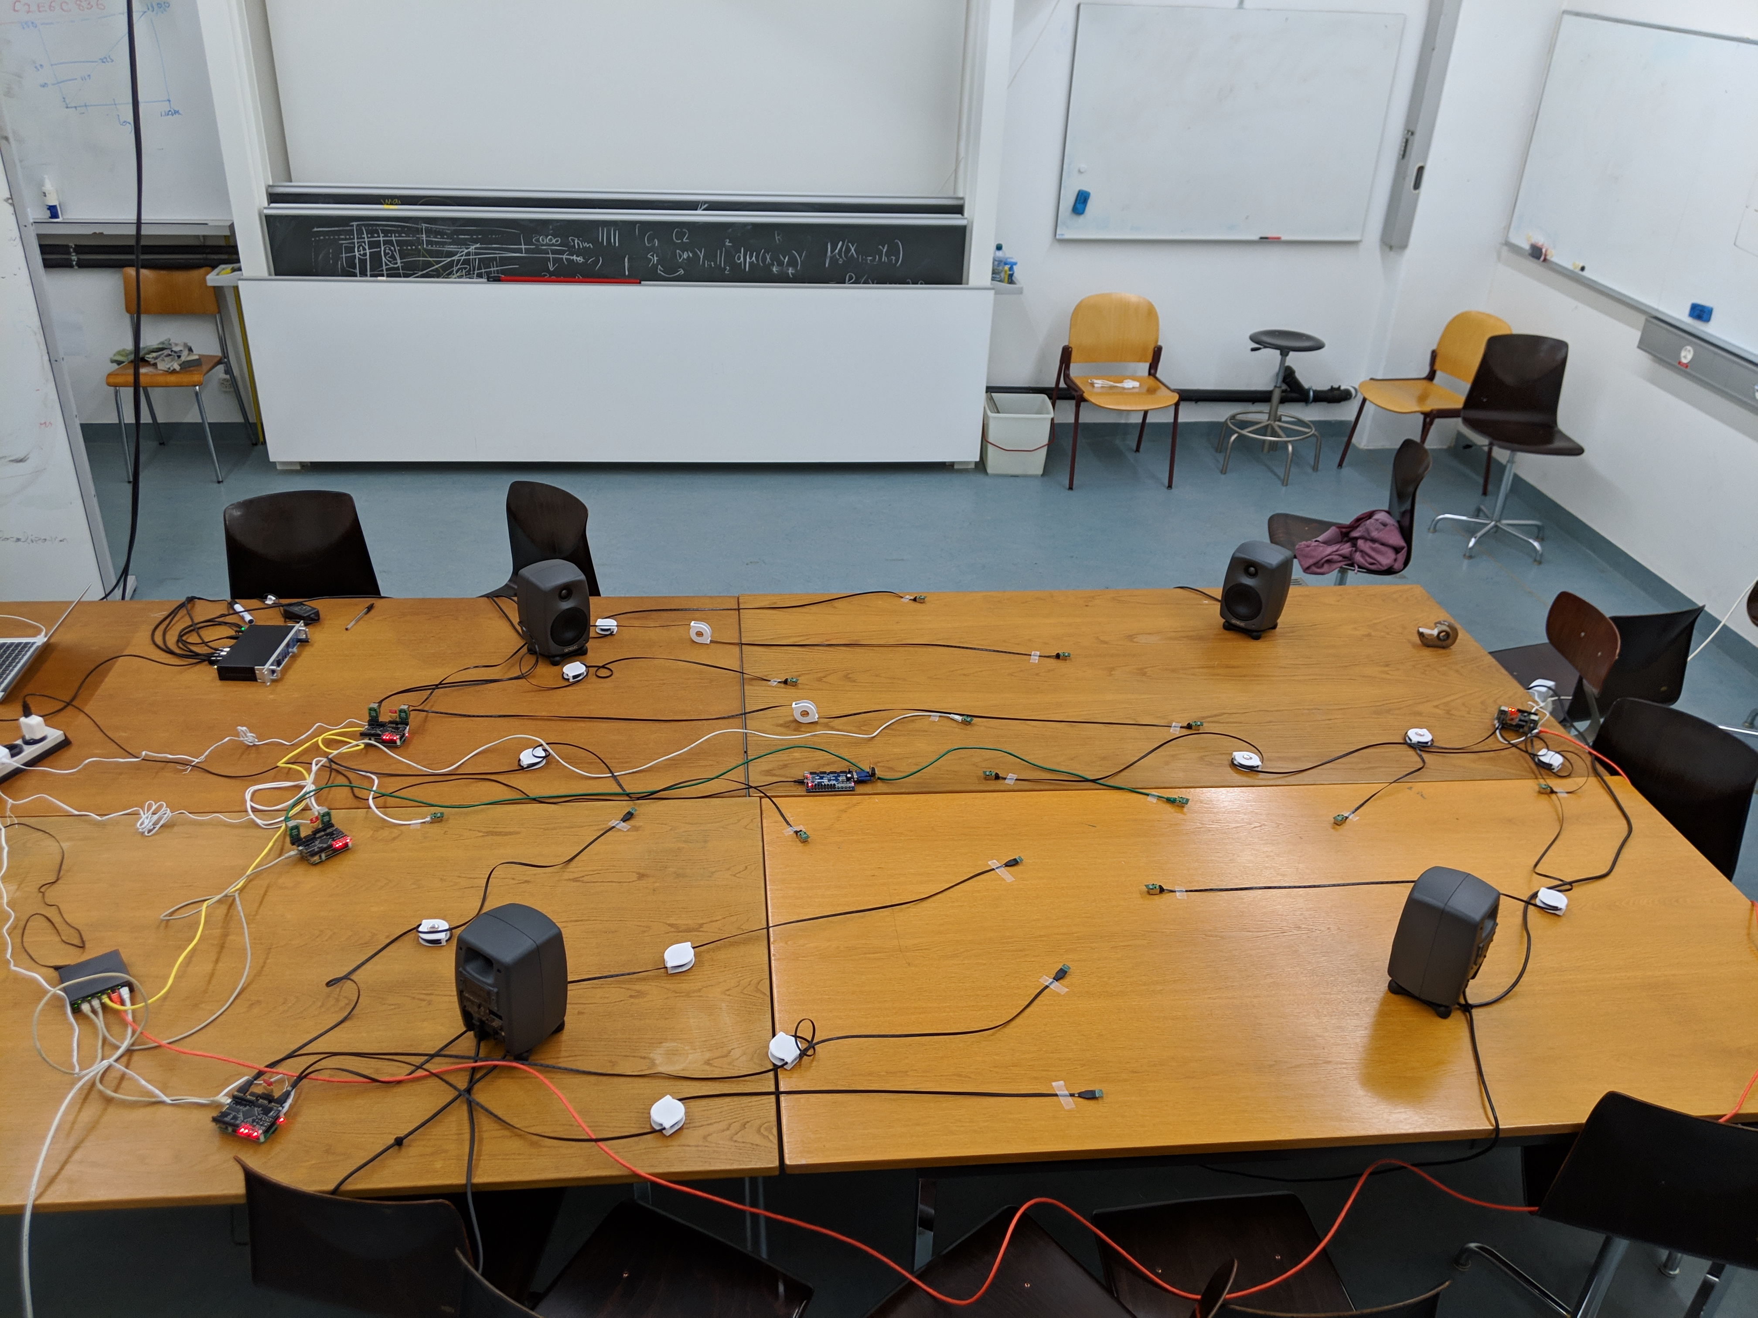

Slide 9
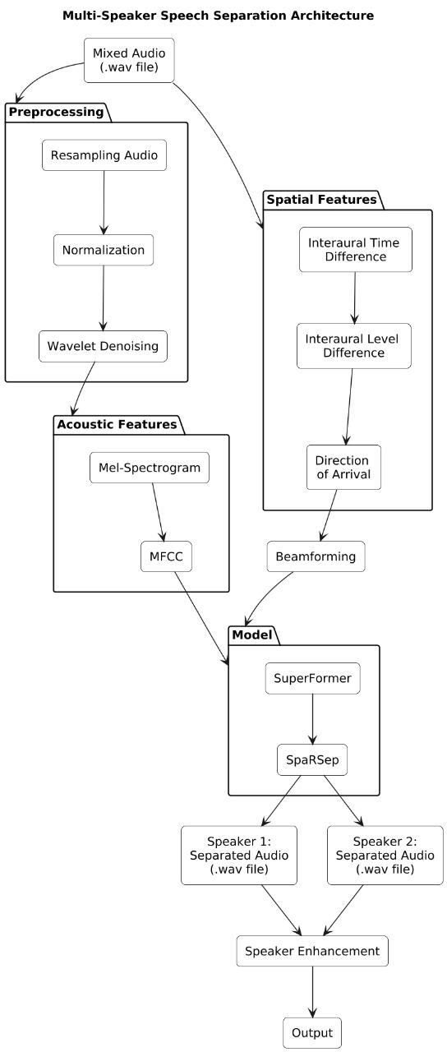
Workflow

Slide 10
Methodology
Preprocessing
Audio Resampling:
Resampled all .wav files to a consistent 16 kHz sampling rate using librosa.resample for uniform audio quality.
Amplitude Normalization:
Normalized audio to [-1, 1] range using torch.max(torch.abs(audio)) to eliminate volume biases.
Wavelet Denoising:
Applied Wiener filter-based denoising with scipy.signal.wiener to enhance signal clarity.

Slide 11
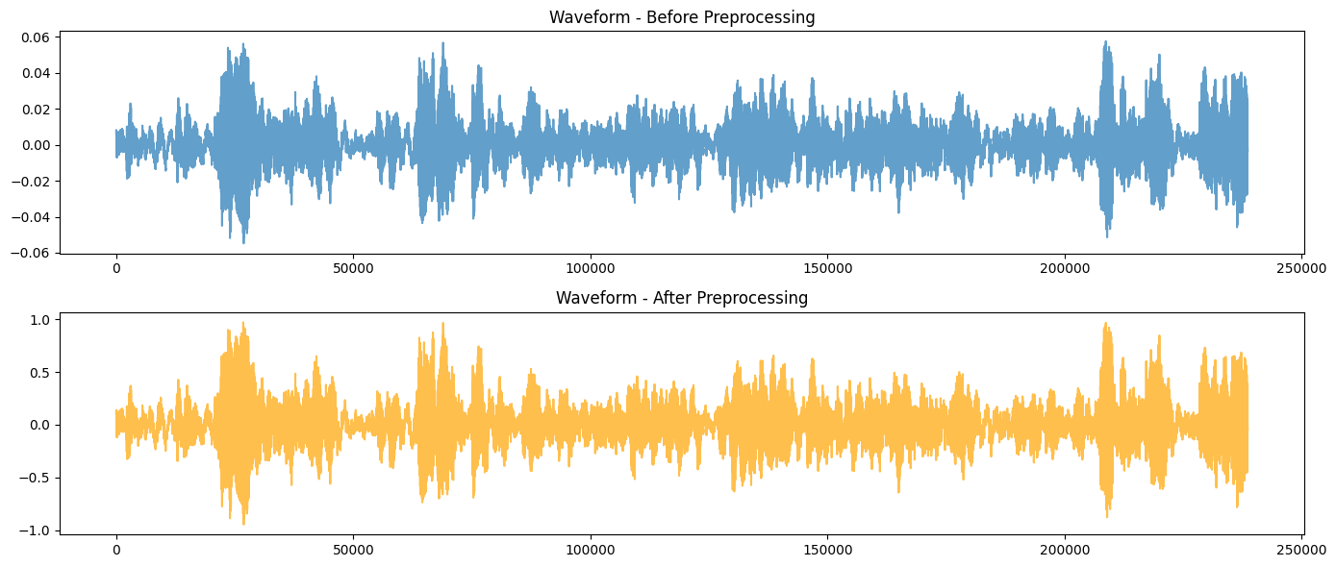

Slide 12
Methodology
Feature Extraction: Acoustic
MFCC Computation:
Extracted 13 MFCCs using torchaudio.transforms.MFCC with matching Mel parameters (1024 FFT, 512 hop, 128 Mel bins).
Feature Visualization and Storage:
Saved Mel-Spectrograms and MFCCs as .png files (e.g., sample_1_mel_spectrogram.png) and preprocessed audio as .wav for further use.

Slide 13
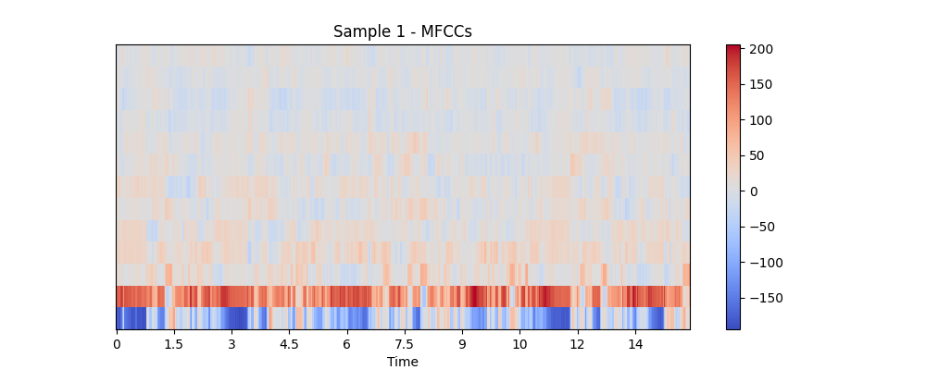
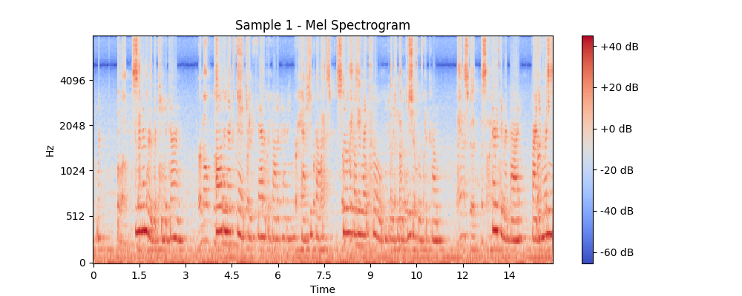

Slide 14
Methodology
Feature Extraction: Spatial
Interaural Time Difference (ITD) Estimation:
Computed ITD using energy-weighted centroid shift method to determine time delays between audio channels.
Interaural Level Difference (ILD) Calculation:
Estimated ILD in dB using mean power analysis to measure amplitude differences across channels.
Direction of Arrival (DOA) Determination:
Calculated DOA using Generalized Cross-Correlation with Phase Transform (GCC-PHAT) to estimate sound source angles.
Beamforming Application:
Applied simple beamforming with weighted summation (e.g., [0.6, 0.4]) and saved beamformed audio as .wav files for further use.

Slide 15
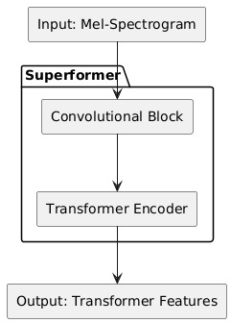
Methodology
Models:
Superformer:
Processes Acoustic Features: Extracts and models temporal and spectral patterns from Mel-Spectrograms using CNN and Transformer layers.
Enhances Speech Dependencies: Captures local and global relationships in the audio data for improved separation.
Architecture: Combines 2D CNN layers (16, 32 channels) with 4 Transformer Encoder layers and 8 attention heads.
Output: Transforms input into a high-dimensional feature space (32 × n_mels/4) for fusion.
Function: Processes acoustic features (Mel-Spectrograms) to capture local and global speech dependencies.

Slide 16
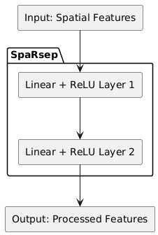
Methodology
Models:
SpaRsep:
Analyzes Spatial Features: Transforms ITD, ILD, and DOA into a refined feature space using Linear layers and ReLU activation.
Supports Localization: Provides spatial context to aid in distinguishing speaker positions.
Architecture: Consists of 2 Linear layers with ReLU activation, mapping 3D spatial features to a 128D hidden space.
Function: Extracts and refines spatial cues (ITD, ILD, DOA) for integration with acoustic features.
Output: Provides a processed spatial feature vector for cross-attention.

Slide 17
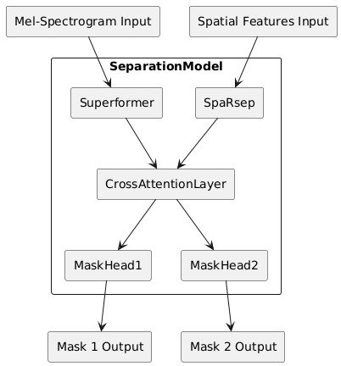
Methodology
Models:
SeparationModel:
Fuses Features: Combines acoustic outputs from Superformer and spatial outputs from SpaRsep via Cross-Attention.
Generates Separation Masks: Produces two masks to isolate and reconstruct audio for Speaker 1 and Speaker 2.
Architecture: Integrates Superformer, SpaRsep, and CrossAttentionLayer, with two mask heads (Linear layers) for speakers.
Function: Fuses acoustic and spatial features to generate separation masks, applied to Mel-Spectrograms.
Output: Produces two sigmoid masks for separating Speaker 1 and Speaker 2 audio.

Slide 18
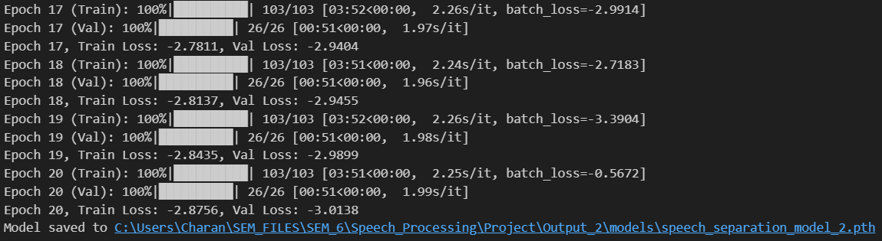
Results
Epochs of Training

Slide 19
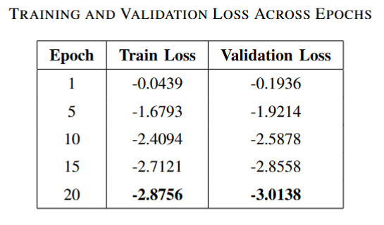
Results

Slide 20
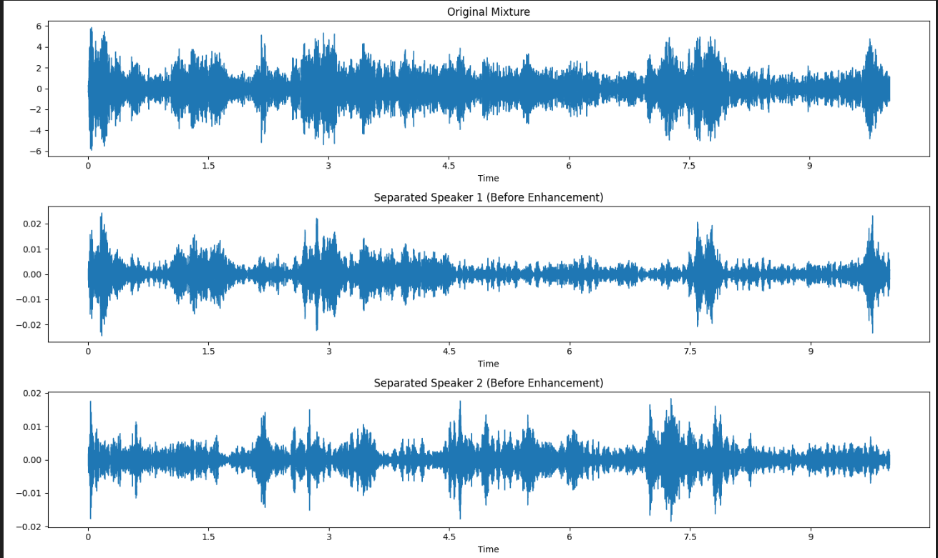
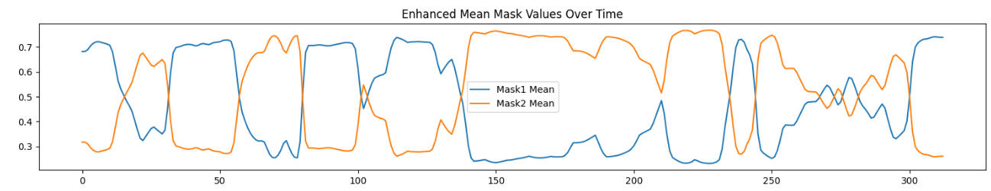
Results
Waveform before Enhancement:

Slide 21
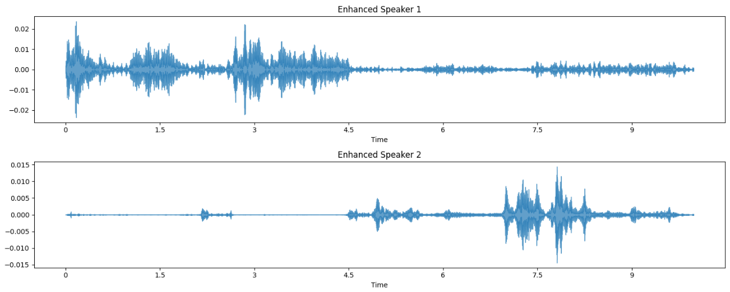
Results
Waveform After Enhancement:

Slide 22
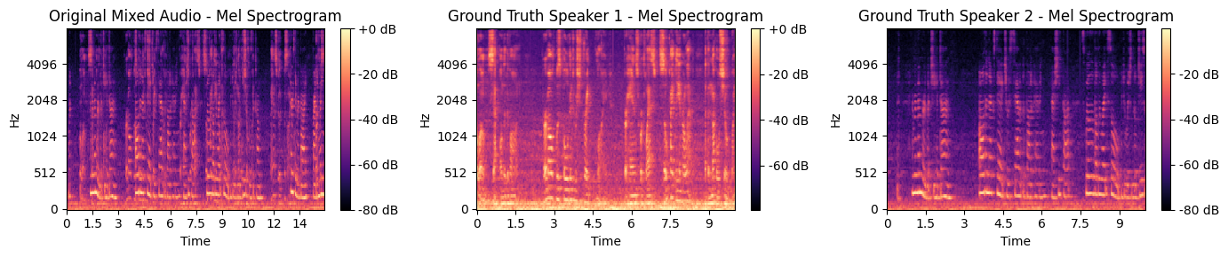
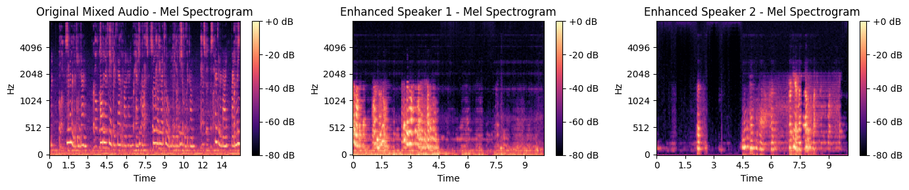
Results
Comparison between Ground truth & Separated enhanced speaker

Slide 23
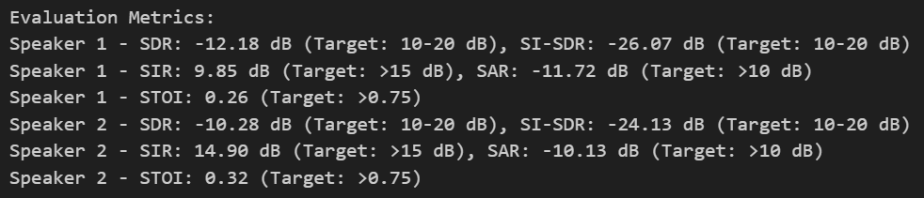
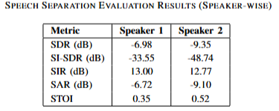
Results
Evaluation Metrics for one test file:
Evaluation Metrics Avg Values for some test files :

Slide 24
Conclusion
Successful Integration: Effectively combined acoustic (Mel-Spectrograms, MFCCs) and spatial (ITD, ILD, DOA) features for speech separation.
Innovative Model: Developed a hybrid SuperFormer+SpaRsep model with cross-attention, enhancing separation performance on WHISPER SET.
Promising Results: Achieved initial separation with trainable masks, though SDR/SI-SDR metrics need further optimization.
Future Potential: Scope for real-time deployment, multi-speaker extension, and refined loss functions to boost accuracy.

Slide 25
References
[1] A. Hyvärinen and E. Oja, “Independent Component Analysis: Algorithms and Applications,” Neural Networks, vol. 13, no. 4-5, pp. 411–430, 2000.
[2] B. D. Van Veen and K. M. Buckley, “Beamforming: A Versatile Approach to Spatial Filtering,” IEEE Transactions on Acoustics, Speech, and Signal Processing, vol. 5, no. 2, pp. 4–24, 1988.
[3] J. R. Hershey, Z. Chen, J. Le Roux, and S. Watanabe, “Deep Clustering: Discriminative Embeddings for Segmentation and Separation,” in Proc. IEEE International Conference on Acoustics, Speech and Signal Processing (ICASSP), 2016, pp. 31–35.
[4] Z. Chen, Y. Luo, and N. Mesgarani, “Deep Attractor Network for Single-Microphone Speaker Separation,” IEEE/ACM Transactions on Audio, Speech, and Language Processing, vol. 25, no. 9, pp. 1786–1797, 2017.
[5] Y. Luo and N. Mesgarani, “Conv-TasNet: Surpassing Ideal Time-Frequency Magnitude Masking for Speech Separation,” in Proc. IEEE/ACM Transactions on Audio, Speech, and Language Processing, vol. 27, no. 8, pp. 1256–1266, 2018.

Slide 26
References
[6] C. H. Knapp and G. C. Carter, “The Generalized Correlation Method for Estimation of Time Delay,” IEEE Transactions on Acoustics, Speech, and Signal Processing, vol. 24, no. 4, pp. 320–327, 1976.
[7] A. Vaswani, N. Shazeer, N. Parmar, et al.., “Attention Is All You Need,” in Proc. Advances in Neural Information Processing Systems, vol. 30, pp. 5998–6008, 2017.
[8] L. Dong, S. Xu, and B. Xu, “Speech-Transformer: A No-Recurrence Sequence-to-Sequence Model for Speech Recognition,” in Proc. Interspeech, 2018, pp. 588–592.
[9] Y. Luo and N. Mesgarani, “SepFormer: Improving Separation with Attention,” in Proc. IEEE International Conference on Acoustics, Speech, and Signal Processing (ICASSP), 2020, pp. 21–25.
[10] R. Gu, S. X. Zhang, and D. Yu, “Neural Spatial Filter for Multi-Channel Speech Separation,” IEEE Journal of Selected Topics in Signal Processing, vol. 14, no. 6, pp. 1181–1193, 2020.

Slide 27
Thank You
Group – 14 ( Batch-B )

